Slide 1

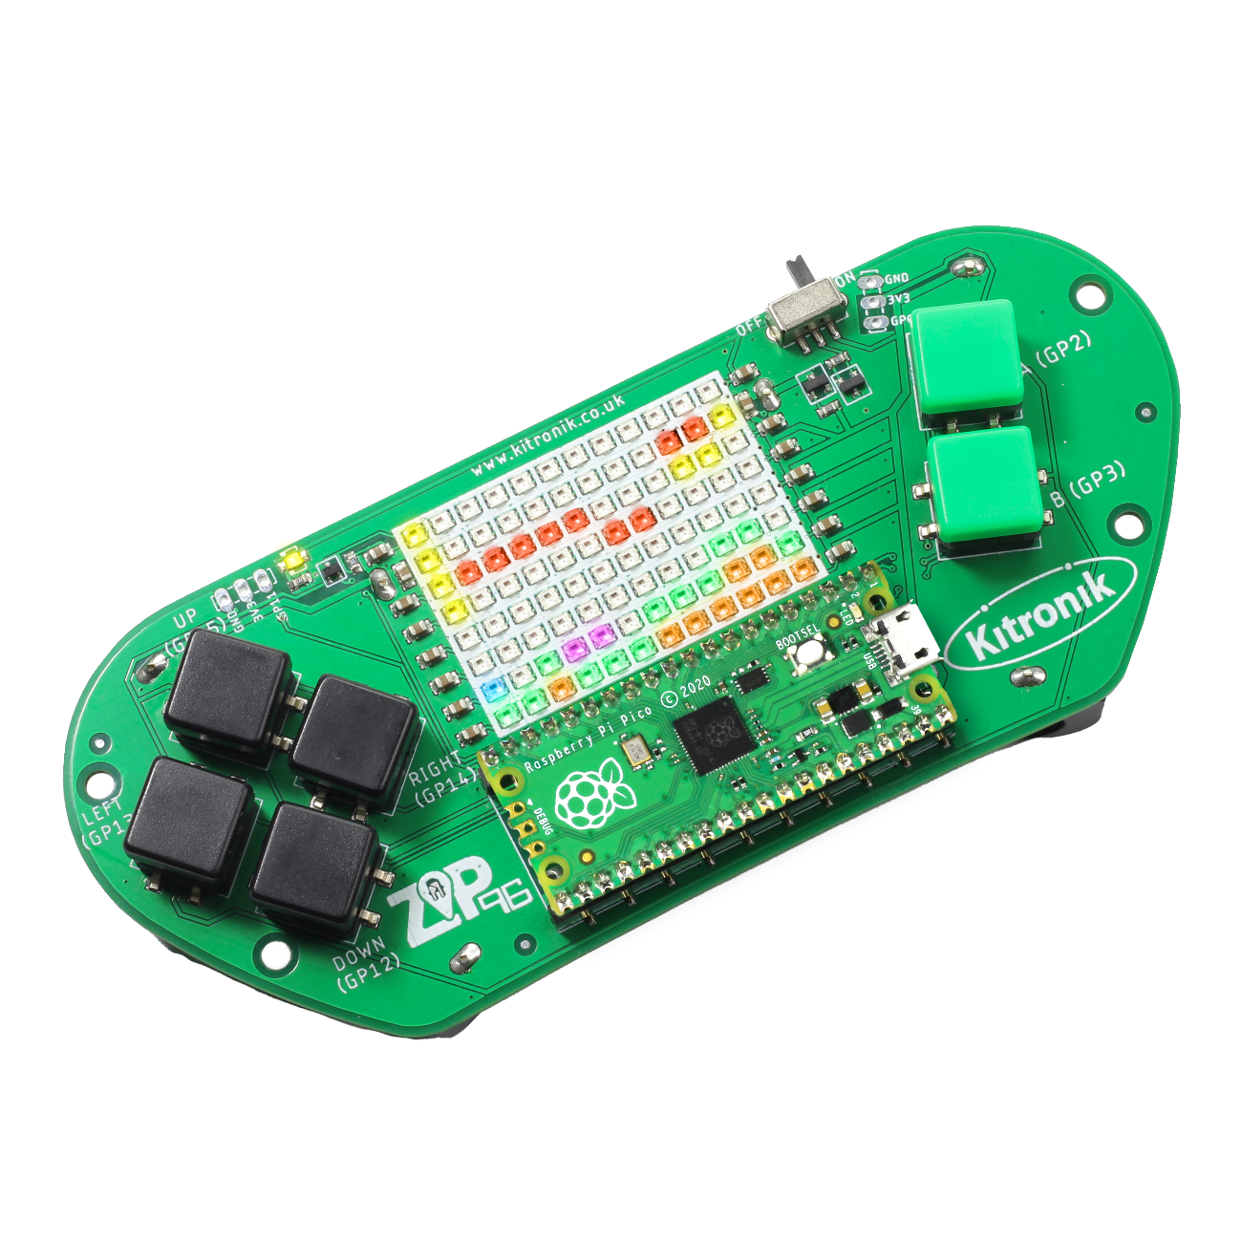
creating the a-mazing game
Computer Science

Slide 2

Aims & objectives
Computer Science
By the end of this lesson you will have:
Create a third Enemy object.
Written the code for a search algorithm to enable the third enemy to find the shortest route through the maze to the player.
Completed the A-Mazing Game.

Slide 3
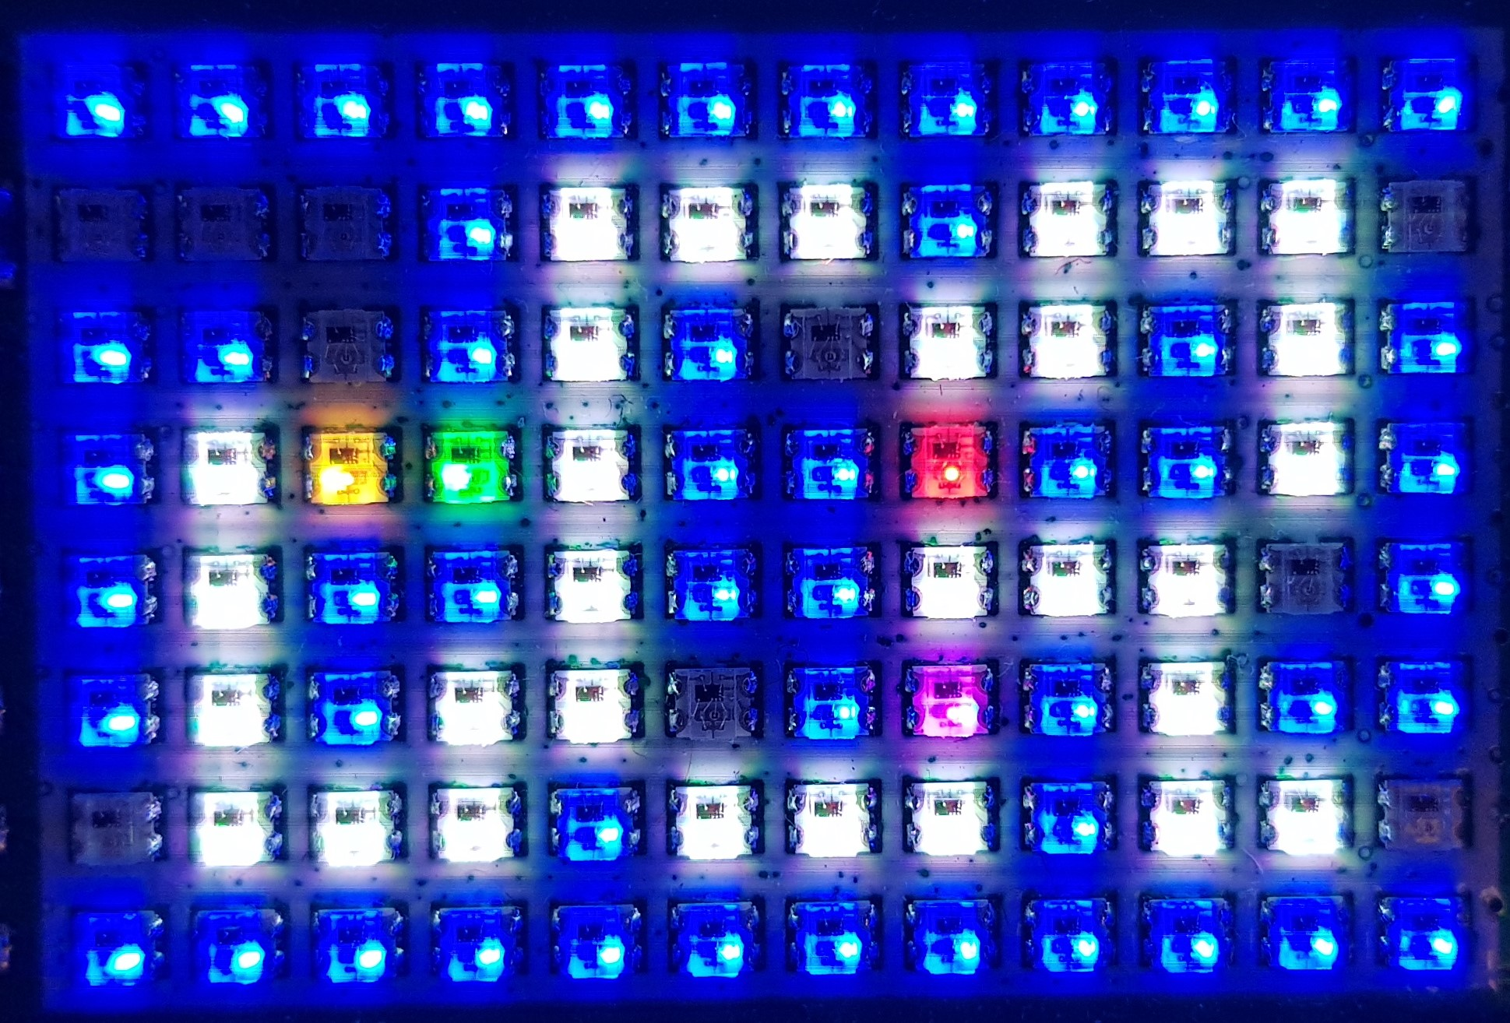
What is our a-mazing game?
Computer Science
A maze-based game where the player runs through a maze collecting gems – collect all the gems to win.
Three different enemies move around the maze as well, trying to stop the player from collecting gems.
One enemy moves randomly, one simply tries to move towards the player, the final one is smart and finds the best path through the maze to the player.
If an enemy catches the player, they lose a life. Once all three lives are lost… game over!

Slide 4
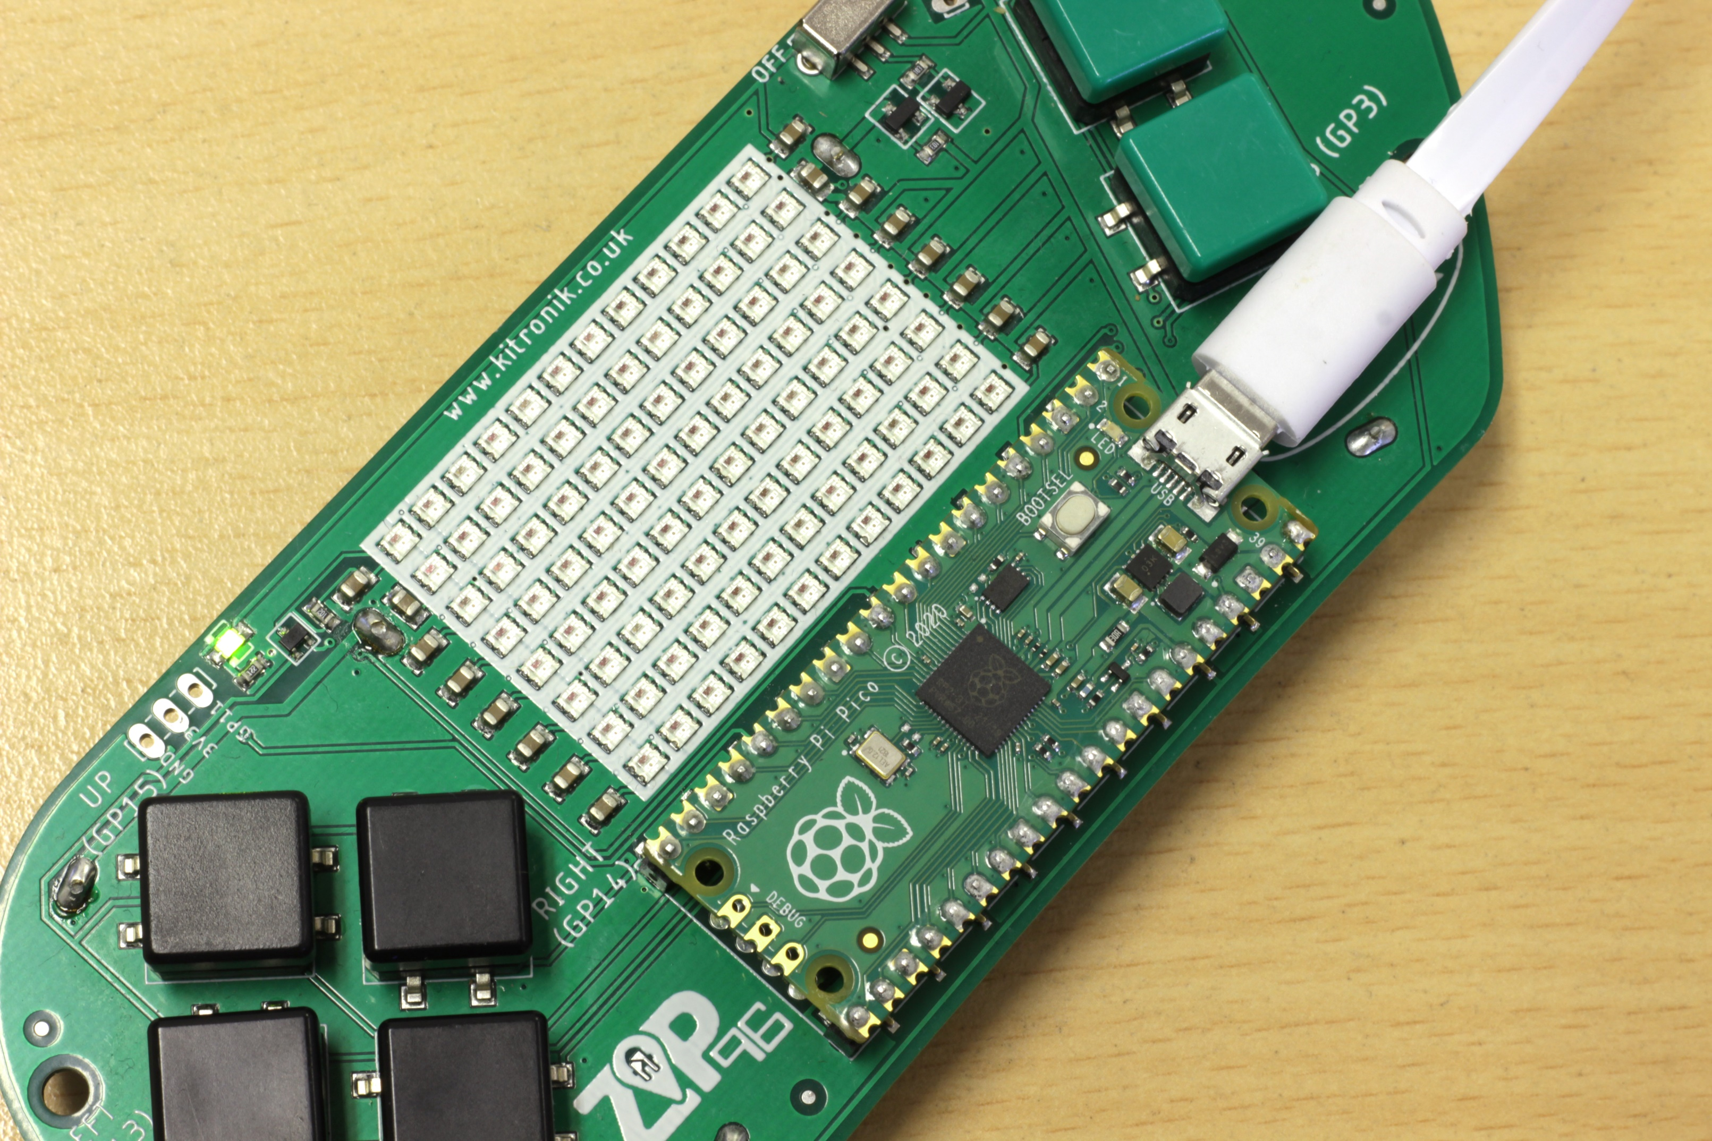
Thonny setup
Computer Science
Connect Pico ZIP96 to computer using a USB cable and open Thonny.

Slide 5
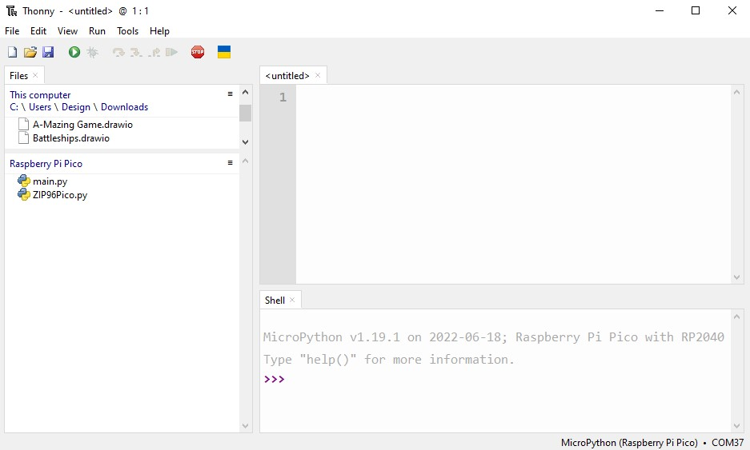
Thonny setup
Computer Science
Check the Pico device appears in the bottom right corner of Thonny.
Try pressing STOP if it does not appear automatically.
Turn on the ‘Shell’ by going to ‘View > Shell’.

Slide 6
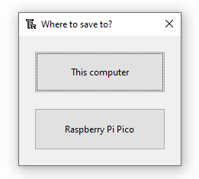
Thonny setup
Computer Science
Create a new file by clicking ‘File > New’.
Save it to the Pico by clicking ‘File > Save as’ and then select ‘Raspberry Pi Pico’.
Name the file ‘main.py’.

Slide 7
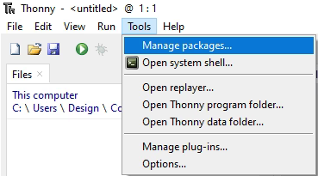
Thonny setup
Computer Science
Install the ‘ZIP96Pico’ library onto the Pico.
Click on ‘Tools > Manage Packages…’

Slide 8
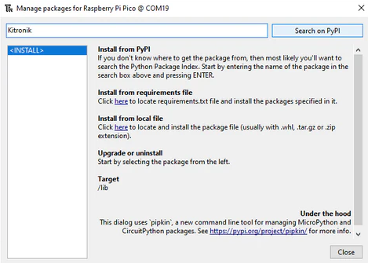
Thonny Setup
Computer Science
With the ‘Manage packages’ window open, search for ‘Kitronik’ and click the ‘Search on PyPI’ button.
Locate ‘KitronikPicoZIP96’ in the list of search results, then click the ‘Install’ button.
Confirm the install by clicking ‘Yes’ if prompted by Thonny.

Slide 9
Coding: define position class
Computer Science
After the Enemy class, define a new class:
# Class to store our Position functionality. Used by Enemy.moveSmart()
class Position():
# Position object constructor
def __init__(self, x, y, travelled):
self.x = x
self.y = y
self.travelled = travelled

Slide 10
Coding: start third enemy
Computer Science
Inside the Enemy class, after the moveNormal() function:
# Update the current position towards Player x, y
def moveSmart(self):
# Reset the current position on the screen
self.drawEmpty()
# Reset hitPlayer
self.hitPlayer = False

Slide 11
Coding: continue third enemy
Computer Science
Continuing in the new moveSmart() function:
# Create new Position at Player x, y with travelled distance zero
current = Position(self.player.x, self.player.y, 0)
# List of Positions to check
self.toVisit = [current]
# List of Positions already checked
self.visited = [[None for x in range(self.screenWidth)] for y in range(self.screenHeight)]

Slide 12
Coding: continue third enemy
Computer Science
Continuing in the new moveSmart() function:
# While we have Positions to visit
while self.toVisit:
# Take the end Position from toVisit
# Lowest distance travelled from Player at the end of the list
current = self.toVisit.pop()
# Add the Position to the visted list
self.visited[current.y][current.x] = current
# Check if we have returned to the Enemy from the Player
if self.collision(current.x, current.y):
break

Slide 13
Coding: add collision to enemy
Computer Science
After the moveSmart() function, define a new function:
# Check if the given x and y are the same as our current position
def collision(self, x, y):
return self.x == x and self.y == y

Slide 14

How to check Position?
Computer Science
There are four conditions which need checking, two for the x and two for the y coordinate. Rather than using four separate if statements, what can be used to reduce it to two?

Slide 15
Coding: position checking
Computer Science
After the moveSmart() function, define a new function:
# Updates toVisit list with a valid Position
def moveSmartUpdate(self, x, y, travelled):
# Check the new x position is valid (not off the edge of the screen)
if (x < 0 or x >= self.screenWidth): return
# Check the new y position is valid (not off the edge of the screen)
if (y < 0 or y >= self.screenHeight): return
# Check each Wall in our list
for wall in self.walls:
# If the Enemy is colliding with a Wall
if wall.collision(x, y):
# Not a valid move so return
return

Slide 16
What is insertion sort?
Computer Science
An algorithm used to sort an array of elements.
Split an array into two sections; the first part at the start of the array is unsorted, and the second part at the end of the array will be sorted.
Look at the first element in the unsorted section and move it into its correct place in the sorted section of the array (ordered by size – loop through values until correct).
Repeat the above steps until the unsorted section of the array is empty.

Slide 17
Coding: insertion sort algorithm
Computer Science
Continue in the moveSmartUpdate() function:
# If Position at x, y doesn't exists (is None)
if not self.visited[y][x]:
i = 0
# Check each Position in toVisit
for i in range(len(self.toVisit)):
# If Position in toVisit travelled less distance leave loop
if self.toVisit[i].travelled < travelled: break
# Add new Position toVisit
# Lowest distance travelled from Player at the end of the list
self.toVisit.insert(i, Position(x, y, travelled))

Slide 18
Coding: check current position
Computer Science
Continue in the moveSmart() function, in the while loop:
# Add the Positions around the current Position into the toVisit list,
# and increase their travelled distance by 1
self.moveSmartUpdate(current.x + 1, current.y, current.travelled + 1)
self.moveSmartUpdate(current.x - 1, current.y, current.travelled + 1)
self.moveSmartUpdate(current.x, current.y + 1, current.travelled + 1)
self.moveSmartUpdate(current.x, current.y - 1, current.travelled + 1)

Slide 19
Coding: get enemy position
Computer Science
Continue in the moveSmart() function, after the while loop:
# Get the current Enemy Position from the visited list
current = self.visited[self.y][self.x]
# Set the Enemy travelled distance
self.travelled = current.travelled

Slide 20
Coding: boundary checking
Computer Science
After the moveSmartUpdate() function, define a new function:
# Checks if a position is the shorted path to the Player
def moveSmartCheck(self, x, y):
# Check the new x position is valid (not off the edge of the screen)
if (x < 0 or x >= self.screenWidth): return
# Check the new y position is valid (not off the edge of the screen)
if (y < 0 or y >= self.screenHeight): return

Slide 21
Coding: distance checking
Computer Science
Continuing in the moveSmartCheck() function:
# Get Position at x, y from visited
checked = self.visited[y][x]
# If Position exists (is not None)
# And the distance travelled from Player is less
if checked and checked.travelled < self.travelled:
# Update the lowest distance travelled
self.travelled = checked.travelled
# Change the current position to the x and y parameters
self.x = x
self.y = y

Slide 22
Coding: find shortest path to player
Computer Science
Continue in the moveSmart() function:
# Check the Positions around the current Enemy Position,
# to see which has the shortest distance from the Player
self.moveSmartCheck(current.x + 1, current.y)
self.moveSmartCheck(current.x - 1, current.y)
self.moveSmartCheck(current.x, current.y + 1)
self.moveSmartCheck(current.x, current.y - 1)

Slide 23
Coding: finish third enemy function
Computer Science
At the end of the moveSmart() function:
# Empty our lists of Positions
self.toVisit.clear()
self.visited.clear()
# If the Enemy is colliding with the Player
if self.player.collision(self.x, self.y):
# Set hitPlayer
self.hitPlayer = True
# Update the new position on the screen
self.draw()

Slide 24
Coding: add enemy functionality to game
Computer Science
Add the third enemy object to the list:
In the game loop, after the moveRandom() call, add the third enemy:
In the livesUpdate() function, reset the third enemy:
# List to store our Enemy objects
enemies = [Enemy(6, 2, gamer.Screen.RED, walls, gems, player, screen, screenWidth, screenHeight),
Enemy(5, 5, gamer.Screen.GREEN, walls, gems, player, screen, screenWidth, screenHeight),
Enemy(10, 4, gamer.Screen.PURPLE, walls, gems, player, screen, screenWidth, screenHeight)]
elif i == 1: enemies[i].moveNormal()
# Third Enemy finds a path to the Player
else: enemies[i].moveSmart()
Run the program to test how the third enemy functions
# Reset the Enemy positions
enemies[0].reset(6, 2)
enemies[1].reset(5, 5)
enemies[2].reset(10, 4)

Slide 25
conclusion
Computer Science
In this lesson you have:
Setup an array and 2D array.
Implemented a basic 2D search algorithm.
Implemented an insertion sort based sorting algorithm.
Used a for loop, if statement and Boolean logic to check for interaction between Enemy and other objects.

